Slide 1
Optimizing Generative AI On ARM (Chapter 1)

Slide 2
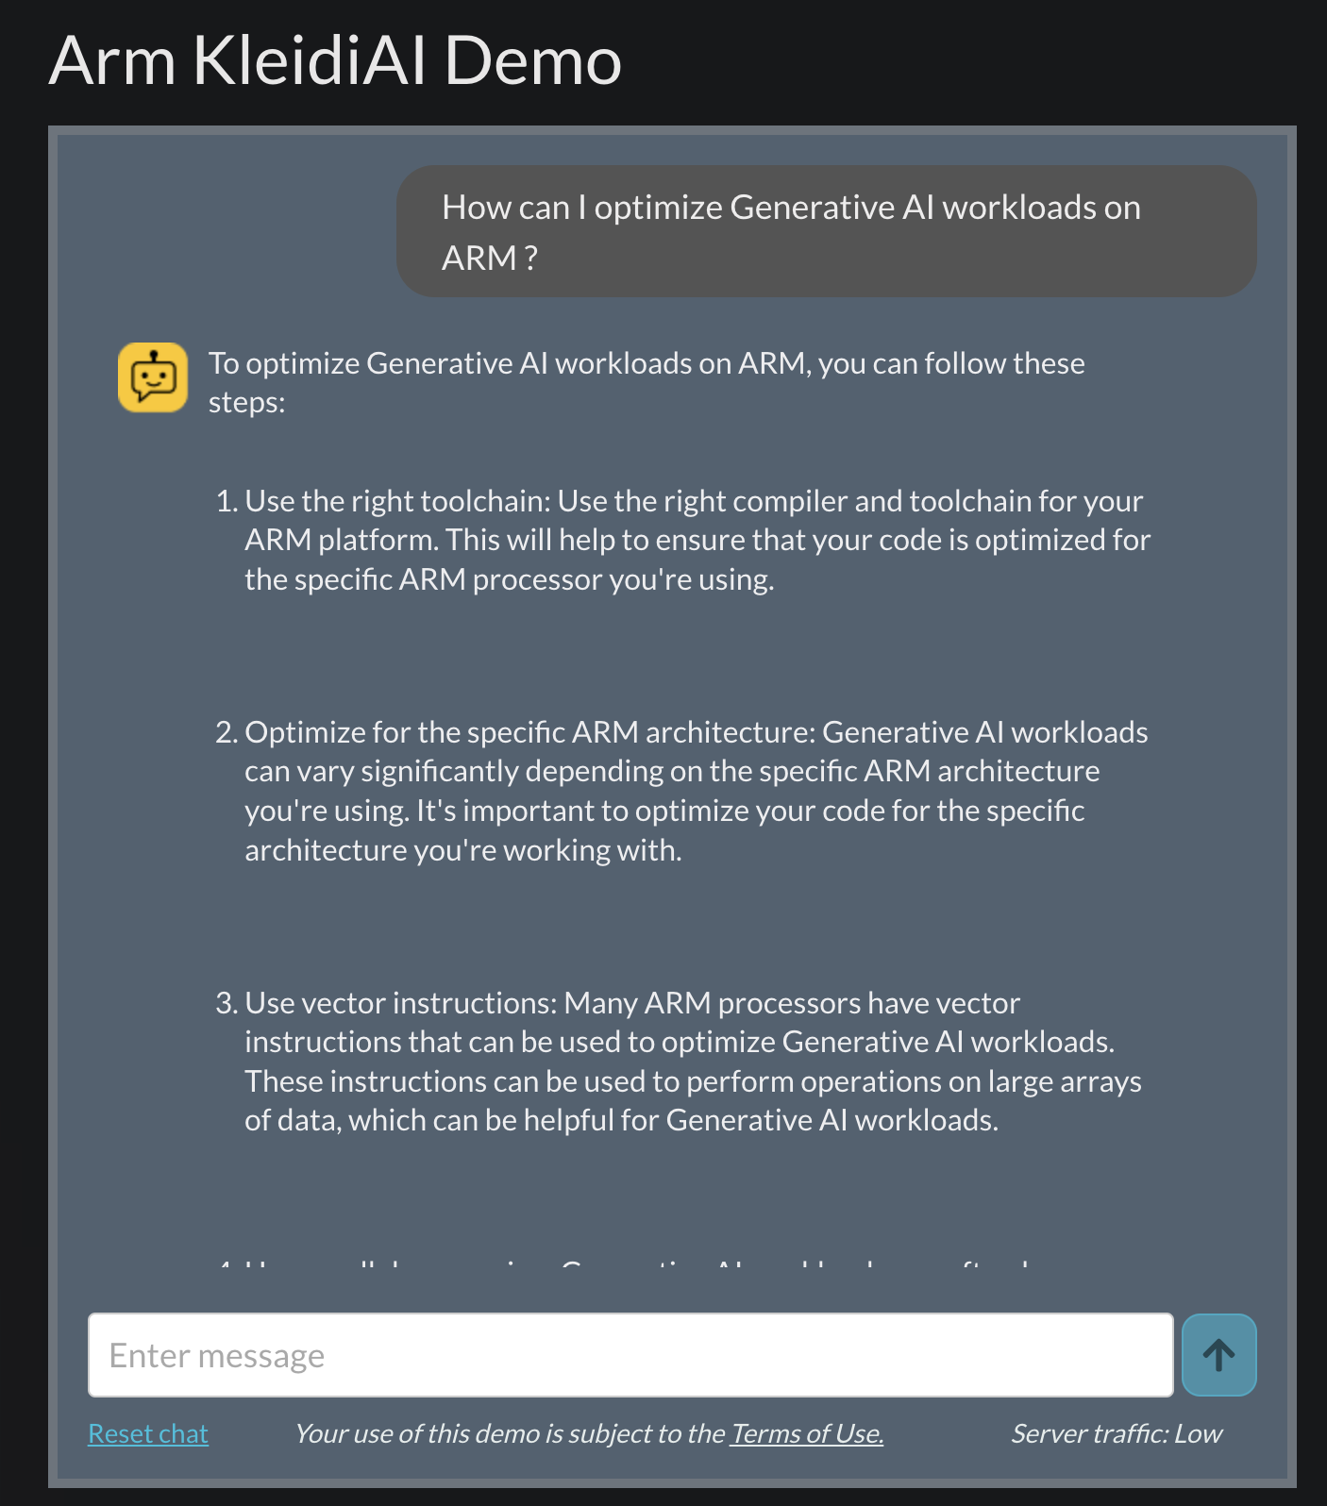
Course Introduction
AI is becoming pervasive in today’s ecosystem
Whether it is the Cloud or the Edge, Generative AI applications are becoming increasingly capable
Examples:
TimeKettle’s real-time on-device language translation
Apple’s on-device OpenELM language assistant
Perplexity.ai’s cloud Answer Engine
And many more…

Slide 3


Course outline
This course will provide you with the understanding and practical experience in deploying and optimizing generative AI workloads on cloud and device CPU’s. The course consists of two parts, a set of 4 lectures and 3 labs.
Lecture 1: Challenges facing Edge and Cloud Inference
Lecture 2: Types of Machine Learning Models
Lecture 3: ML Frameworks and Optimized Libraries / Kernels
Lecture 4: Optimization for CPU Inference
Lab 1: Optimizing Generative AI Workloads with Arm Edge Processors
Lab 2: Optimizing Generative AI Workloads on cloud Arm Processors
Lab 3: Comparative Inference Benchmarking on Arm cloud and Edge Devices

Slide 4
Challenges Facing Cloud and Edge GenAI Inference
Navigating Memory Constraints and Architectural Differences

Slide 5
Lecture 1 Learning Outcomes
Understanding Memory Constraints: Understand how limited memory impacts AI model deployment on edge devices
03
Recognise Generative AI Trends: Recognize the exponential growth of Model Compute and Data and its implication for inference.
01
Device Architecture Differences: Comprehend the fundamental differences between CPU and GPU processor architectures.
02
Understanding Computational Constraints: Learn how to device throughput affects AI model deployment on edge devices.
04

Slide 6

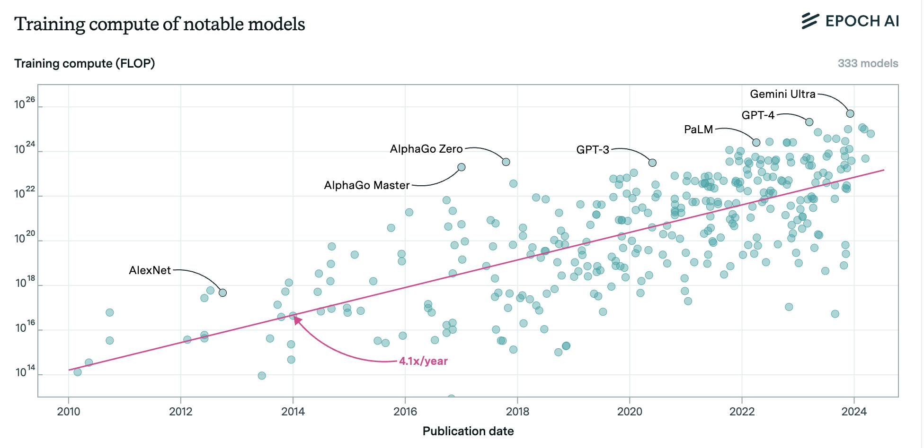
Model Size Trends
Scaling the Training and Inference of GenAI models in compute makes them more capable.
Jaime Sevilla and Edu Roldán (2024), "Training Compute of Frontier AI Models Grows by 4-5x per Year". Published online at epoch.ai.
Sutton, R. S. (2019). The bitter lesson.

Slide 7
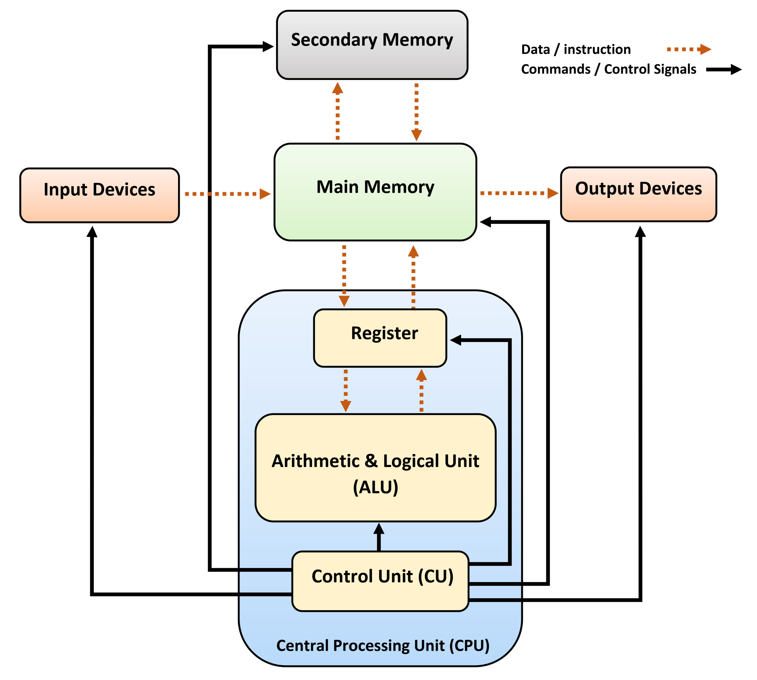
CPU Architecture Overview
Key Components
Arithmetic Logic Unit (ALU): Performs mathematical calculations and logical operations.
Control Unit (CU): Manages and directs the flow of data between the CPU, memory, and hardware components.
Registers: High-speed storage locations that temporarily hold instructions, addresses, and data being processed.
Features:
Advanced Control Logic: Designed to efficiently manage a wide range of tasks, enabling execution of complex instructions.
Optimized Single-Thread Performance: Ensures high per-core efficiency, reducing latency for computationally intensive operations.
Branch Prediction & Out-of-Order Execution: Enhances CPU efficiency by reducing pipeline stalls and ensuring continuous instruction execution.

Slide 8
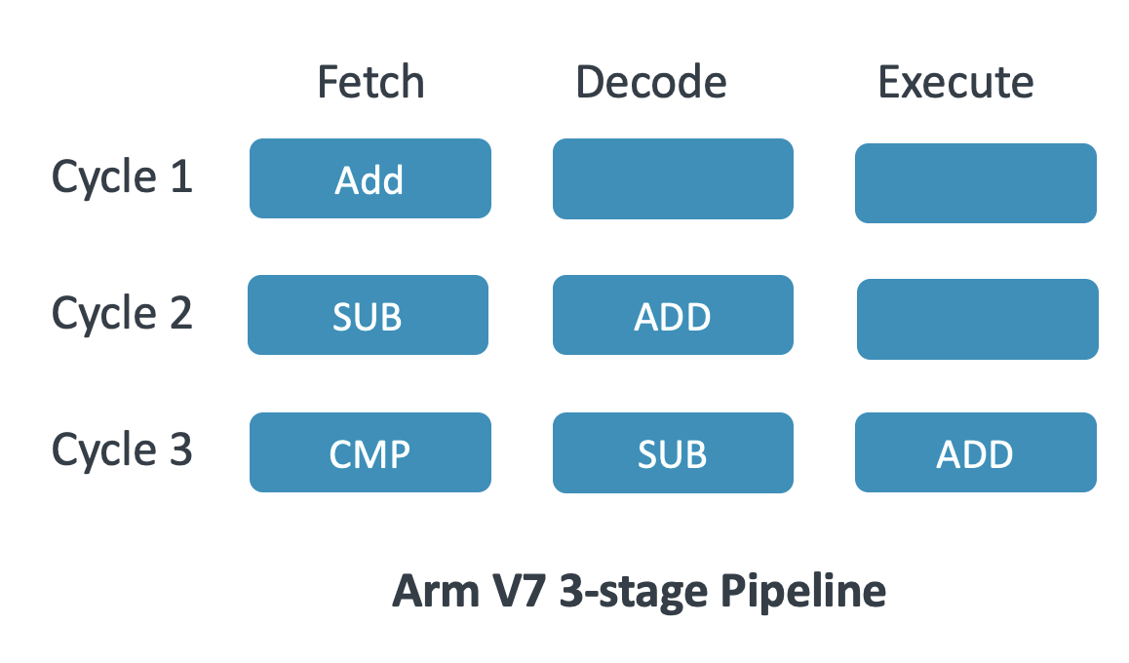
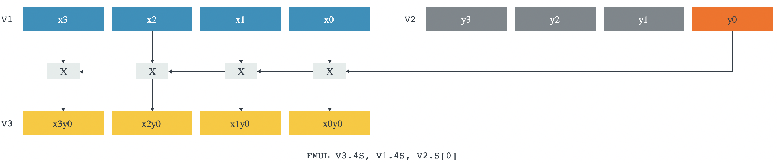
How CPU’s Are Optimized
Instruction Level Parallelism
Pipelining: Executes multiple stages (fetch, decode, execute) simultaneously for higher throughput.
Superscalar Execution: Allows multiple instructions per clock cycle using parallel execution units.
Data Level Parallelism
Single Instruction Multiple Data (SIMD) allow a single instruction to act on multiple data elements e.g. (Arm NEON, SVE).
Scalable Matrix Extension (SME), available on Arm enables 2D data parallelism.
Branch Prediction
Speculative Execution: Predicts branch outcomes to keep the pipeline full, reducing stalls
NEON Vector Multiplication

Slide 9
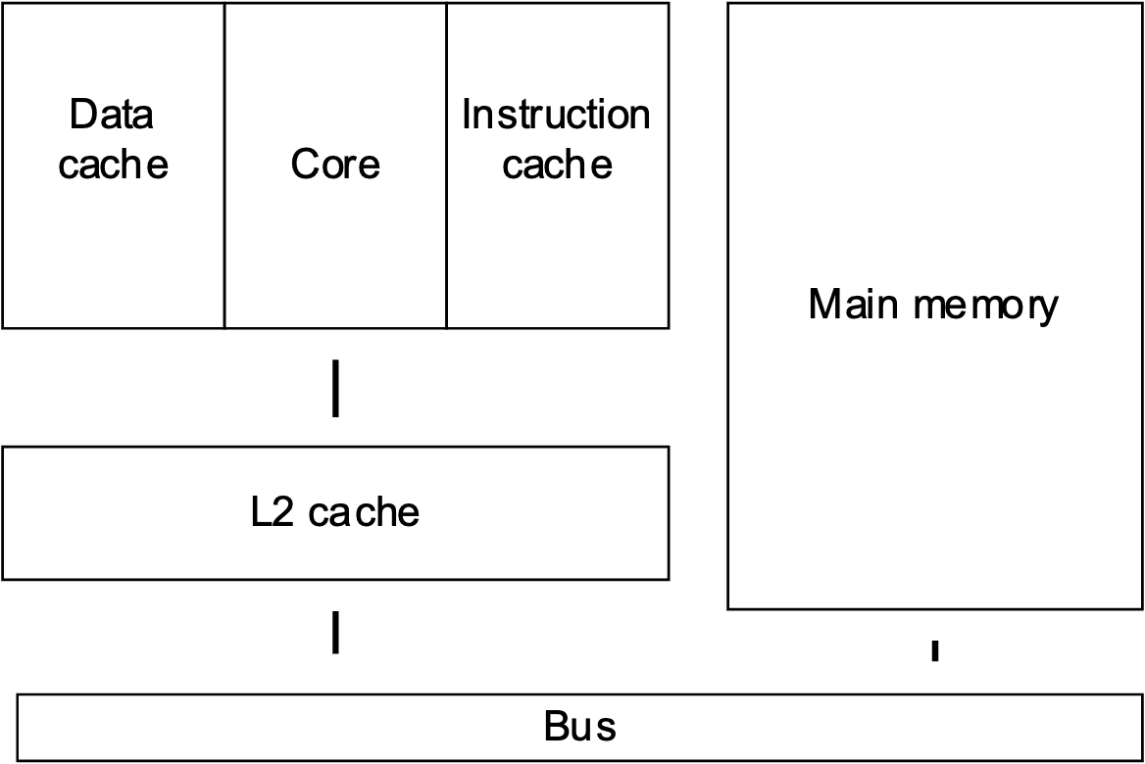
How CPU’s Are Optimized
Cache Optimization
Cache Size & Associativity: Optimizing these reduces cache misses, reducing latency and energy consumption.
Prefetching: Predicts and loads required data in advance to minimize memory delays.
Power Efficiency
Frequency Scaling: Adjusts CPU speed dynamically for power and performance balance.
Low Power States: Reduces power consumption during idle periods.
Multi-Core Architectures.
Parallel Processing: Utilizes multiple cores to handle tasks concurrently.
Typical Harvard Cache

Slide 10
GPU Architecture Overview
Definition and Purpose
GPU (Graphics Processing Unit): A specialized processor designed for parallel computing.
Originally used for graphics rendering, now widely used in AI, scientific computing, and data processing.
Key Components
Compute Units (SMs, CUs, EUs):
Parallelism Models
SIMD (Single Instruction Multiple Data):
SIMT (Single Instruction Multiple Threads):
Memory Hierarchy:
Global/VRAM Memory: High-bandwidth memory for large datasets but with higher latency.
Shared/Local Memory: Reduces memory access times but limited in size.
Registers & Caches: Essential for performance but require careful management.
GPU Challenges:
Parallel focus: Not ideal for serial tasks
Branching overhead: “If” statements SIGNIFICANTLY reduce efficiency
High latency: Single-thread operations are slow

Slide 11
How GPUs Are Optimized
Maximizing Parallelism
Thread Management: Organizing threads efficiently to maximize throughput.
Occupancy Optimization: Maintaining high active threads per compute unit to reduce latency.
Memory Optimization
Memory Coalescing: Aligning memory accesses to improve bandwidth and reduce latency.
Shared Memory Utilization: Using fast shared memory to minimize reliance on slower global memory.
Supported Precisions
Balancing between lower precision (e.g., FP16) and higher precision (e.g., FP32) to optimize performance and resource usage based on application requirements.
MMA units
Matrix Acceleration for AI: Specialized compute units (e.g., Tensor Cores) speed up mixed-precision operations, but dedicated AI accelerators (e.g., ARM NPUs) offer better efficiency for low-power applications.

Slide 12
Architectural Differences on AI Workloads
Feature | CPU | GPU
Core Count | Few high-performance Cores (4-96) | Thousands of smaller higher latency cores
Parallelism | Instruction-Level Parallelism (ILP) with some additional SIMD e.g. (Arm NEON) | Data-Level Parallelism (DLP) using SIMD/SIMT
Control Logic | Advanced control units with branch prediction & out-of-order execution | Simplified control logic optimized for parallel tasks
Memory Hierarchy | Hierarchical caches (L1, L2, L3) optimized for low latency | High Bandwidth Memory (HBM) optimized for high throughput
Execution Model | Mixture Out-of-Order /In-Order Execution for flexible task handling (e.g. sparse networks) e.g. (Arm Big-Little) | SIMD/SIMT for executing multiple threads simultaneously (only suitable for some programs)
Special Features | Advanced Instruction Sets (e.g. Arm SVE2, I8MM, DotProd, SME) | Tensor Cores (Matrix Multiply-Accumulate Units)
Power Efficiency | Energy Efficient per task (especially for RISC based CPUs) 2-5 Watts | High power draw due to large core count 300+ Watts
Latency vs Throughput | Optimized for low-latency | Optimized for high-throughput
Cost | $10- $10,000 (depends on core count & server/local) | $1000 - $50,000+ (depends on VRAM consumer/cloud)

Slide 13
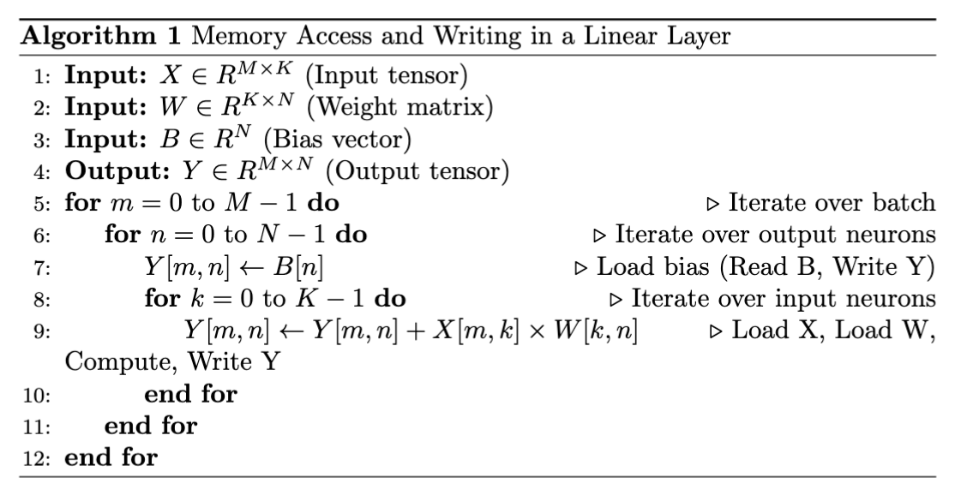
Memory Bottlenecks for AI Inference Workloads
A 70 Billion parameter model at Floating Point 16 precision requires 70B * 2 Bytes = 140Gb of memory.
Model Inference consists mostly of Matrix-Matrix, Matrix-Vector Multiplies.
During Inference, all 140Gb of the model must be read from memory.
Memory read/write latency is critical for inference speed (Gb/s). Can be improved by caching.

Slide 14
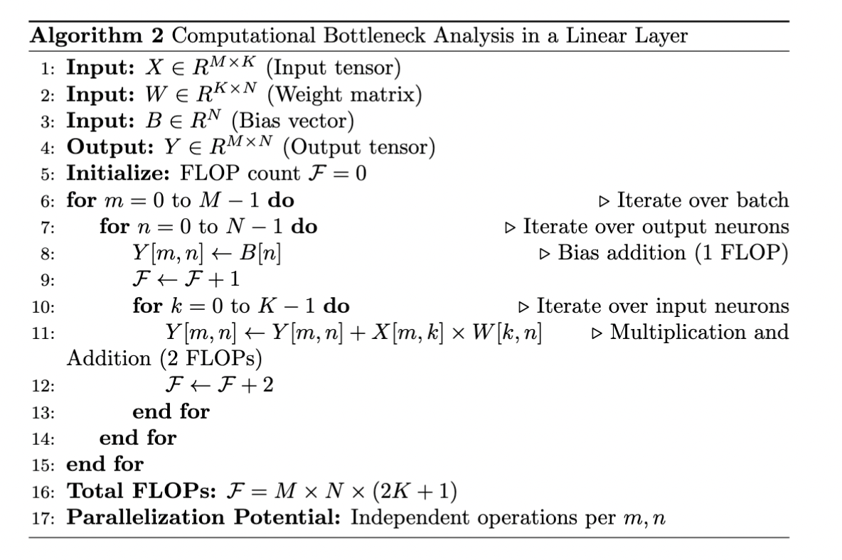
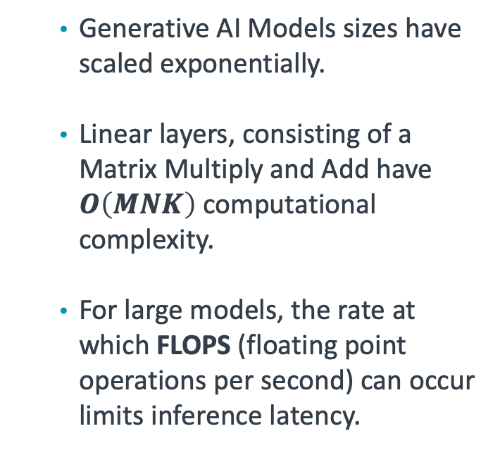
Computation Bottlenecks for AI Inference Workloads
Generative AI Models sizes have scaled exponentially.
Linear layers, consisting of a Matrix Multiply and Add have $O\left(MNK\right)$ computational complexity.
For large models, the rate at which FLOPS (floating point operations per second) can occur limits inference latency.

Slide 15
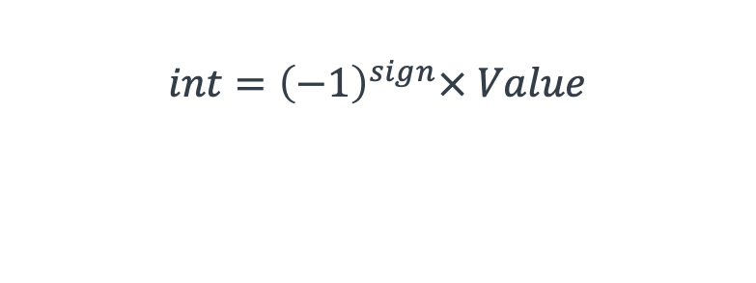
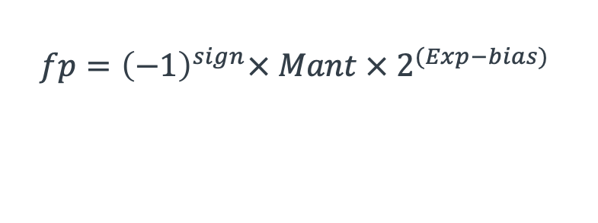
Techniques to Mitigate Memory Constraints
Sign bits
Value bits
Quantization (fp32 -> fp16/bf16 -> int8 -> int4)
Reduces bit width of parameters to lower memory and compute cost.
Minimizes memory bandwidth load when reading model parameters.
Can be applied post-training or during training with quantization-aware training (QAT).
Exponent bits
Mantissa bits
int4
int8
$$int={\left(−1\right)}^{sign}× Value$$
$$fp={\left(−1\right)}^{sign}× Mant × 2^{(Exp−bias) }$$
bf16
fp16
fp32

Slide 16


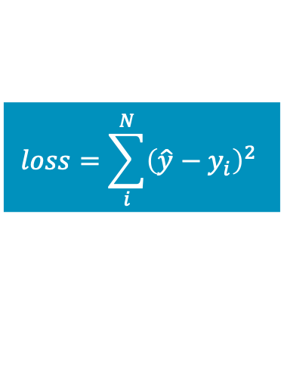
Techniques to Mitigate Memory Constraints
Knowledge Distillation
Compresses a large model into a smaller, efficient model.
A teacher model supervises a student model, transferring knowledge.
Types of Knowledge
Feature Based Knowledge
Logit Based Knowledge
Relation Based Knowledge
Benefits: Reduces parameter count → lower memory and compute cost.
Text, Audio or Image inputs
Teacher
$$loss=\sum_{i}^{N}{{\left({\hat{y}−y}_{i}\right)}^{2}}$$
Student

Slide 17
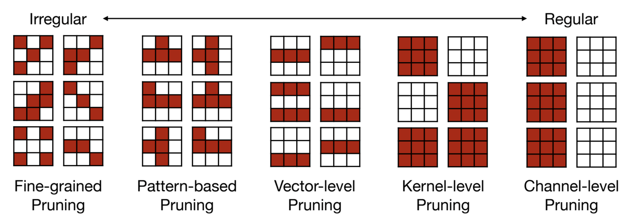
Techniques to Mitigate Memory Constraints
Pruning
Removes redundant parameters, groups, or entire layers of a neural network.
Techniques include:
L1/L2 norm-based pruning (removes small weights).
First-Order Pruning (removes weights, least affecting loss given by first order loss approximation)
Second-Order Pruning (removes weights, least affecting loss given by second order loss approximation)
Mao, Huizi, et al. "Exploring the granularity of sparsity in convolutional neural networks." Proceedings of the IEEE Conference on Computer Vision and Pattern Recognition Workshops. 2017.

Slide 18
Summary of Key Points
Hardware Characteristics
CPU: versatile, low-latency cores optimized for latency-sensitive tasks (Including Advanced SIMD Features such as NEON, I8MM, DotProd, SME)
GPU: Large numbers of parallel cores using SIMD/SIMT execution, optimized for throughput.
Challenges and Solutions in AI Inference
Generative Model Sizes are rapidly increasing, from millions to hundreds of billions of parameters.
Depending on the memory-bandwidth or FLOPS of the device, AI Inference workloads can either be memory-bound or compute-bound.
Optimization Techniques such as Quantization, Distillation, and Pruning help reduce memory, computation, and energy costs.

Slide 19
Questions and Discussion

